Slide 1


Titolo presentazione sottotitolo
ADDITION OF METEOROLOGICAL INFORMATION TO GNSS DATA PROCESSING SOFTWARE
(Master of Science in Geoinformatics Engineering)
Felix Enyimah Toffah - 936545
Milano, XX mese 20XX
Advisor: Prof. Giovanna Venuti Co-Advisor: Andrea Gatti

Slide 2
Outline
Introduction
Objectives
Methodology
Results
Case study
Conclusion

Slide 3
Introduction
Interaction of atmospheric contents and water vapour result in a changing state of the atmosphere and its dependent parameters such as pressure, temperature and humidity.
Instruments for measuring atmospheric parameters
on land (such as thermometer, wind vane and barometer),
on sea (such as acoustic depth sounder)
in the air (such as artificial satellites, aircraft, radiosondes).
Data collected by instruments that operate in the air medium are very helpful as most parameters that influence the changing state of the atmosphere are found there.
Radiosondes are commonly used to measure various atmospheric parameters including water vapour, pressure, and temperature.
Cost of acquiring and establishing a radiosonde station makes it difficult to increase the spatial extent of a radiosonde network (Flores et al., 2013).

Slide 4
GNSS for displacement and atmospheric water vapour monitoring
GNSS is based on observation of satellite signals that travel through and interact with the components of the atmosphere.
It is used for positioning and other scientific purposes.
Accurate positioning has been possible through appropriate modelling of the atmospheric interaction of the satellite signals
ionospheric
tropospheric
The ionospheric delays are caused by the interaction of free electrons in the ionosphere (about 100 and 1000 km altitude) with the satellite signal.
The tropospheric delay is partly caused by the presence of water vapour in the troposphere (0 to 40 km above the Earth Surface).

Slide 5
GNSS for displacement and atmospheric water vapour monitoring
GNSS is based on observation of satellite signals that travel through and interact with the components of the atmosphere.
It is used for positioning and other scientific purposes.
Accurate positioning has been possible through appropriate modelling of the atmospheric interaction of the satellite signals
ionospheric
tropospheric
The ionospheric delays are caused by the interaction of free electrons in the ionosphere (about 100 and 1000 km altitude) with the satellite signal.
The tropospheric delay is partly caused by the presence of water vapour in the troposphere (0 to 40 km above the Earth Surface).

Slide 6
goGPS for GNSS Data Processing
By properly processing the observations collected by a GNSS receiver, it is possible to accurately estimate the receiver position in terms of its coordinates, and additional parameters accounting for the interactions in the troposphere.
- Precise Point Positioning (PPP)
Software for GNSS data processing – goGPS
Implements PPP
Basesd on Matlab
It gives time series of fixed receiver’s coordinates and tropospheric parameters (ZTD, ZWD and ZHD)
goGPS produces, among others, plots of these parameters

Slide 7
Plots
Zenith Tropospheric/Total Delay (ZTD), which represents the delay of a GNSS satellite signal, projected in the zenith direction above a receiver station.
Zenith Wet Delay (ZWD) which represents the wet component of the ZTD
Zenith Hydrostatic Delay (ZHD) representing the hydrostatic component of the ZTD and obtained from the difference between the ZTD and the ZWD
Position coordinates (East, North or Height) of a monitoring station

Slide 8
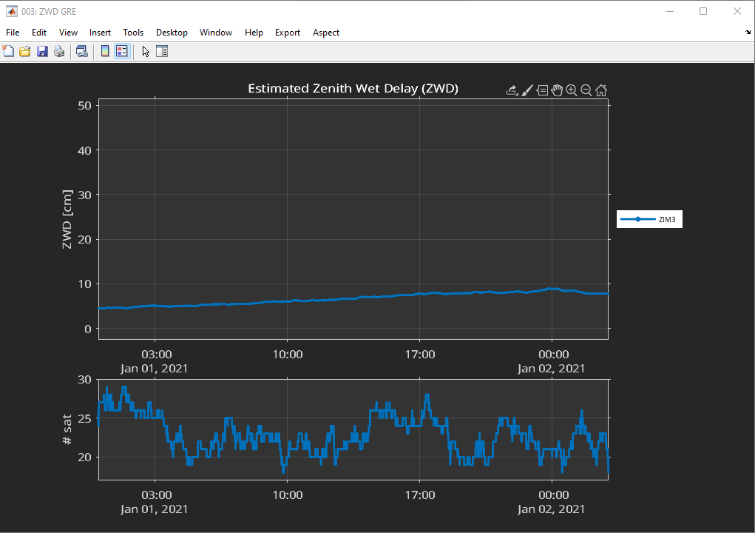
Current interface of plots produced by goGPS

Slide 9
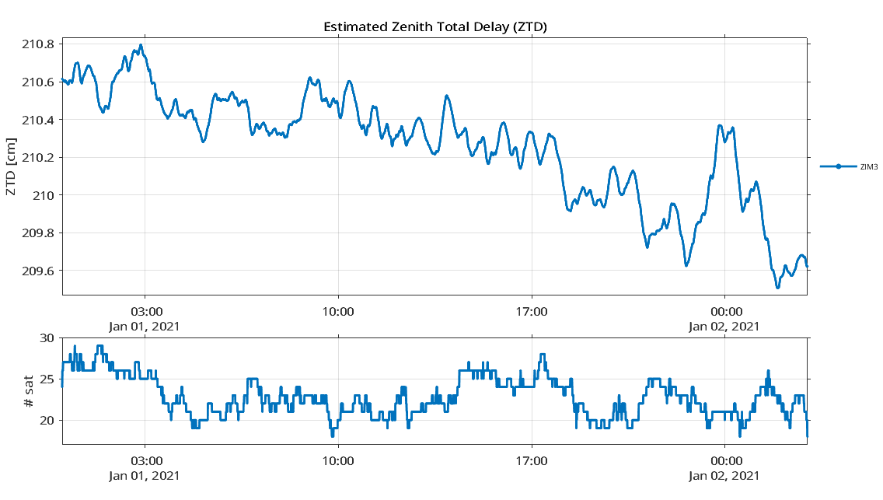
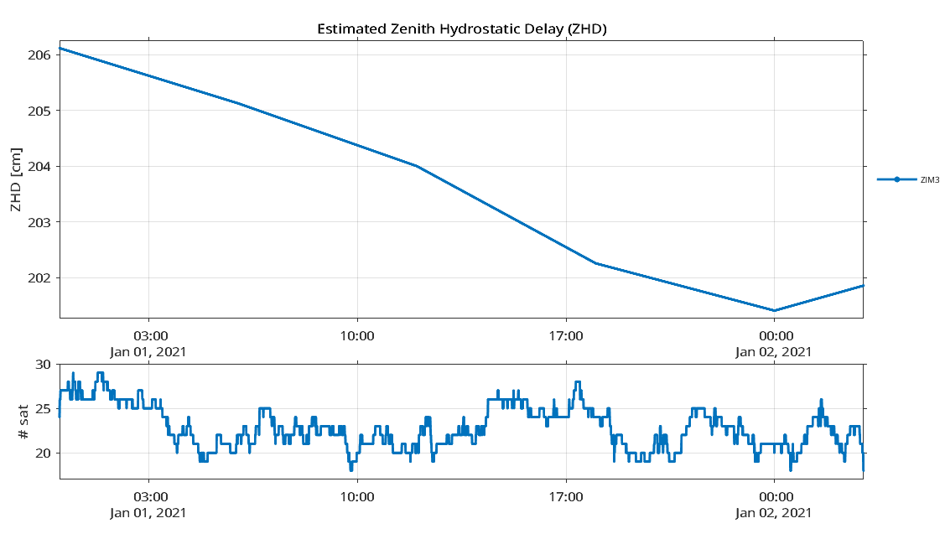
goGPS plot

Slide 10
Events affecting GNSS estimates
It might be useful to know the state of the atmosphere such as the variability of temperature and pressure to better understand the impact of the atmosphere on the time variation of the ZTD and position coordinates.
The observation station is exposed to the atmosphere and the observed signals traverse the atmosphere from the space vehicle to the receivers.
Some events such as earthquake, tsunami and flood can significantly affect the estimated GNSS observations, useful to identify them to make the analysis.

Slide 11
Objective
To add weather parameters such as humidity, temperature and pressure to plots produced by the goGPS software.
This involves extraction of weather data from a source and their display on goGPS plots.
Export of the extracted weather data in a RINEX format

Slide 12
Methodology

Slide 13
Feasibility study
Is it possible to add an image or icon that represents different weather phenomena to a plot in MATLAB?
Is it possible to add weather parameters such as humidity, temperature, pressure, etc. to a plot in MATLAB?
Is it possible to display weather information for more than a day on a plot in MATLAB?
Can the expected system be built at all?
If it can be built, how long will it take to complete it?

Slide 14
Graphical Objects in MATLAB

Slide 15
Requirements identification
Given any specified location in the world, it is required to obtain weather information to be shown on the plots of goGPS.
Given any date of the past, retrieve the weather data.
It is required to show the type of weather (e.g. rainy, snowy, sunny, etc.).
Other parameters useful to be shown on the plots include temperature, humidity, pressure, wind speed, wind direction etc.
The user should be able to hide or show all the parameters by accessing the ‘Show ALL’ item in the Meteo-menu.

Slide 16
Design
(Components identification)

Slide 17
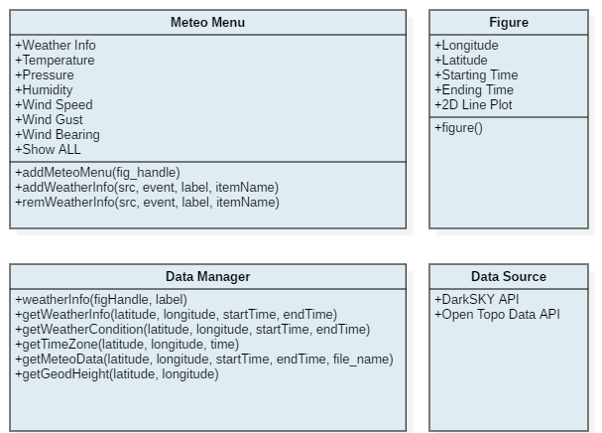
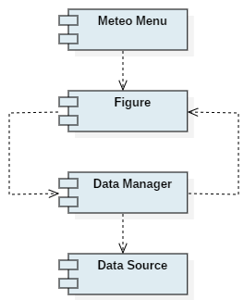
Contents
Component Diagram
Component Interface

Slide 18
Data Sources
DarkSKY API for weather parameters data
provides data that covers the globe
is historical
gives forecast and present weather conditions
It displays its data on the web making its data easier to be read using the webread function of Matlab
Open Topo Data API for station elevation (RINEX met. file)
provides a global elevation dataset (including bathymetry)
developed by the National Oceanic and Atmospheric Administration (NOAA).
has an estimated accuracy of about 10m

Slide 19
Alternative Data Sources
Weather Data | Elevation
Meteoblue weather API - An API key is required | National Geodetic Survey API
Global Surface Summary of the Day (GSOD) of the National Oceanic and Atmopsheric Administration - first download data in CSV format | Open-Elevation API
 | Google Maps Elevation API API keys required and others not public

Slide 20
Design
(Sequence Diagram)

Slide 21
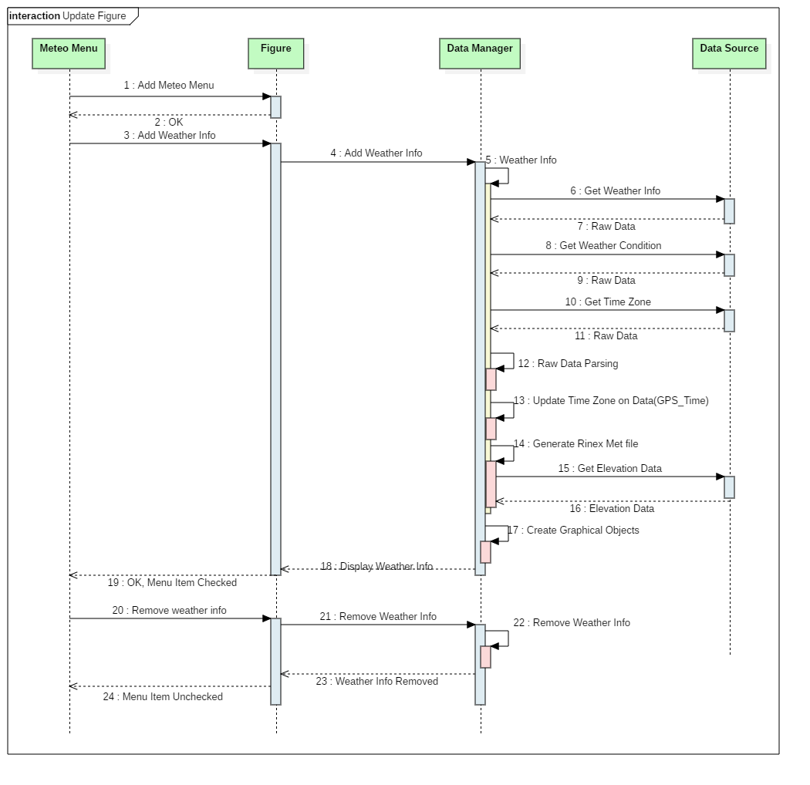
Contents
Sequence Diagram

Slide 22
Development
Preparation of the data
Visualisation of the data
A defensive approach was used at all stages of the implementation to handle cases where the end-user might attempt to use the program incorrectly
For instance, a user might zoom the plot before displaying the icon. So ensure the icons sizes are correct irrespective of the zoom level.

Slide 23
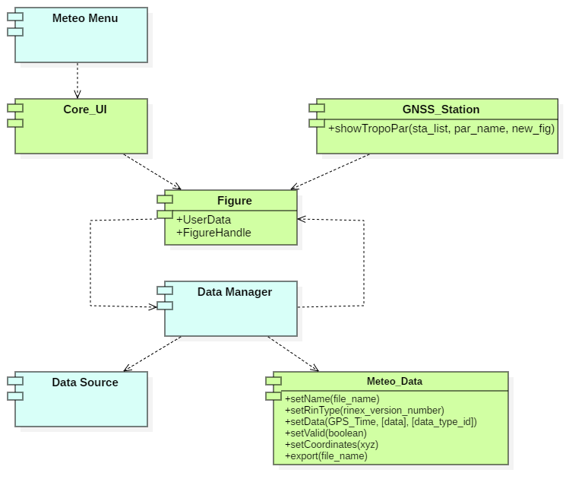
Contents
Dependency Diagram

Slide 24
Testing
Detecting faults in the program
- Fault-based testing
Detecting errors in the program
- Error-based testing
Checking that the program satisfies the requirements specified at the beginning of the project
- Coverage-based testing
Bottom-up approach
unit testing
integration testing
system testing
acceptance testing.

Slide 25
Test Plan

Slide 26
Deployment
GitHub repository of goGPS MATLAB

Slide 27
Maintenance
Reducing maintenance problems (techniques of Vliet (2007))
By writing higher-quality code, better test procedures, better documentation and adherence to standards and conventions;
By anticipating changes during requirements engineering and design and by taking them into account during realisation, future perfective and adaptive maintenance can be realised more easily.
Fine tuning to user needs may lead to savings in perfective maintenance.
By writing less code
Additional requirements might evolve through daily usage
Continuous communication with GReD s.r.l.

Slide 28
Results

Slide 29
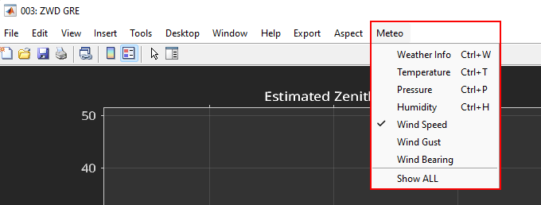
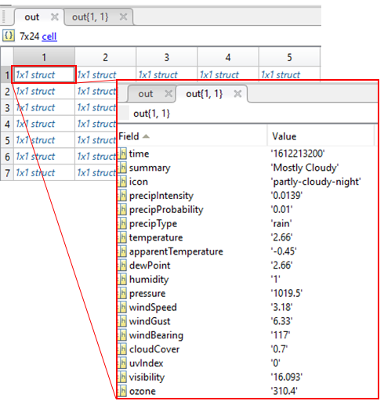
Menu item and Data Structure

Slide 30
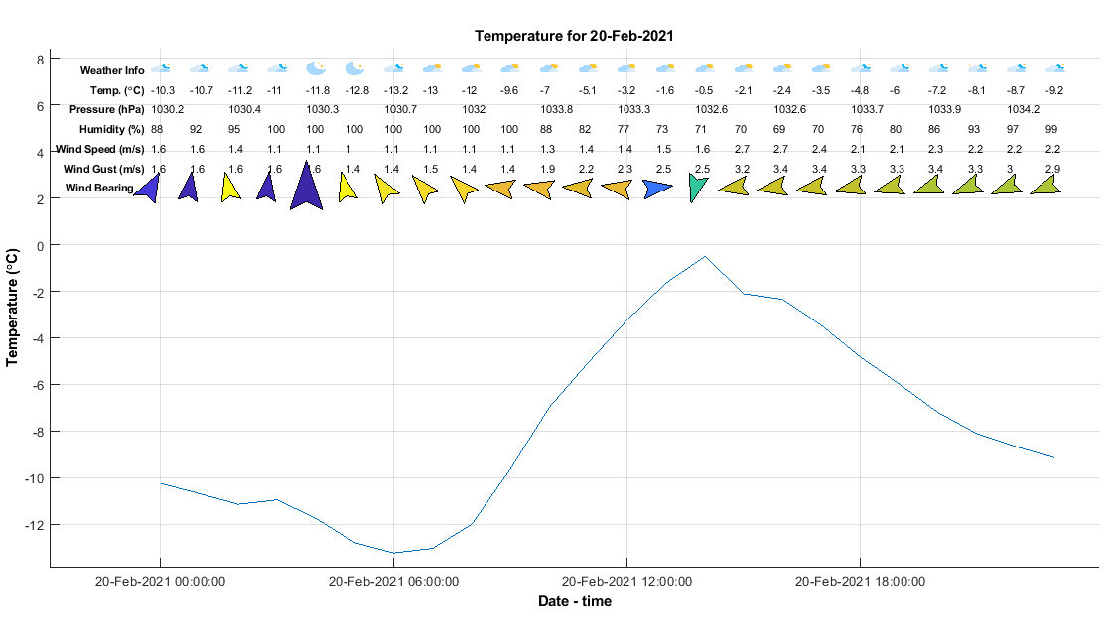
Display of data for less than 30-hour period

Slide 31
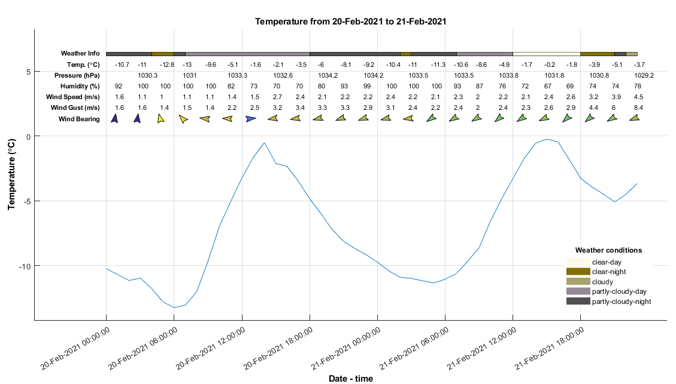
Display of data for more than 30-hour period

Slide 32
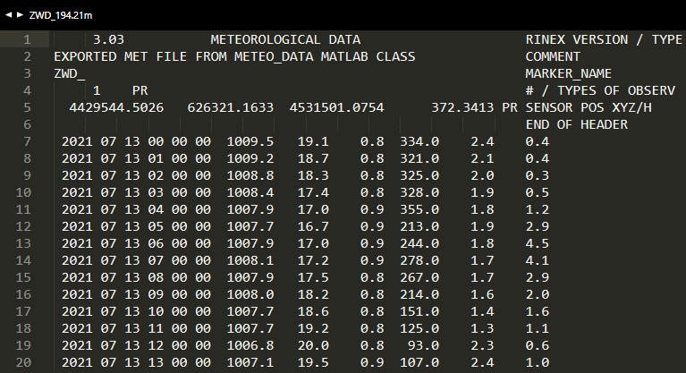
Rinex Meteorological Data File
Pressure (mbar)
Dry temperature (°C)
Relative humidity(%)
Wind azimuth (°)
Wind speed (m/s)
Rain increment (1/10 mm)

Slide 33

Case Study – Malpensa Airport, Italy
July 13, 2021
Emirates' Boeing 777-300ER (A6-ECF) damaged by hail storm on its way to John F. Kennedy (JFK) International Airport, New York City
The flight departed Milan Malpensa airport at 16:23 but returned at 18:04.
Damages with shattered windshields, nose cone, engine cowlings and wings.

Slide 34
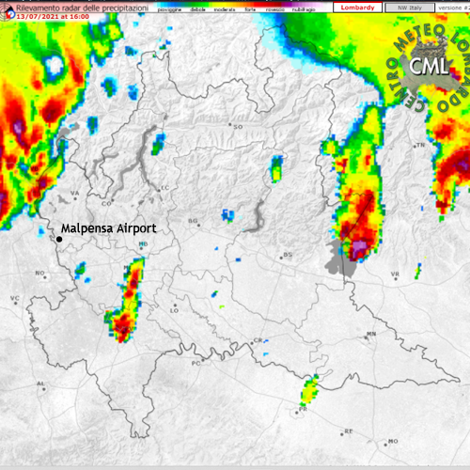
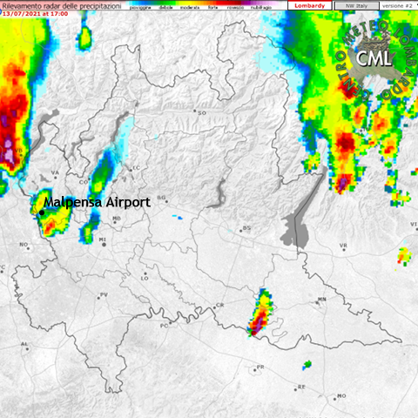
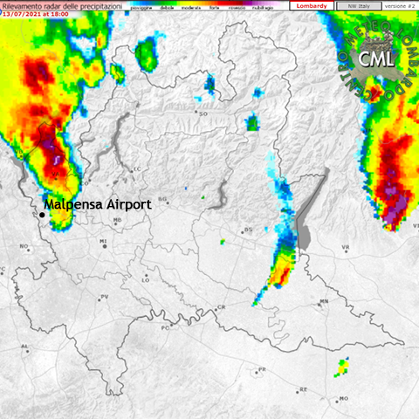
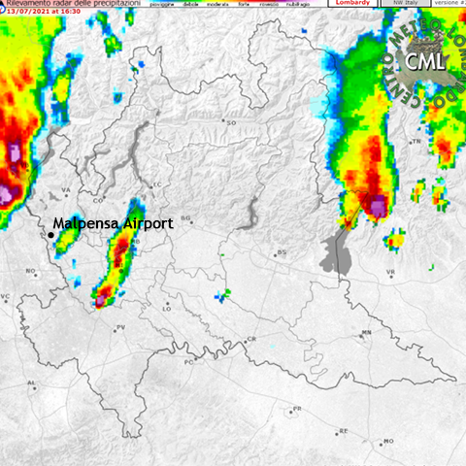
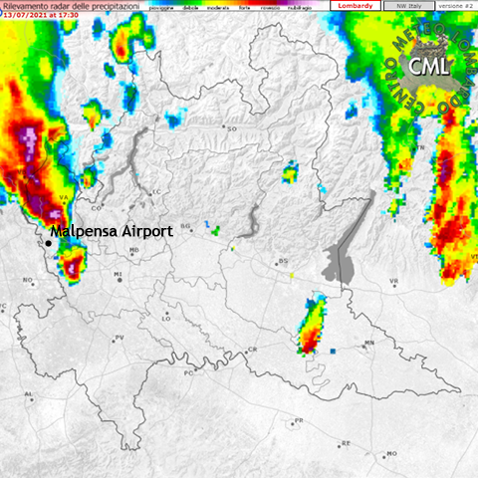
Case Study – Radar Images
1
3
5
2
4

Slide 35
Identification of precipitation type by colour on Radar map - Hebby (2022)
Colour on Radar Map | Precipitation Type
Light green | Light rain, or light rain aloft not reaching ground
Dark green | Light to moderate rain
Yellow | Moderate rain
Orange | Heavy rain
Red | Very heavy rain or rain and hail
White or blue | Snow
Pink | Freezing rain or sleet or mix of winter precipitation types

Slide 36
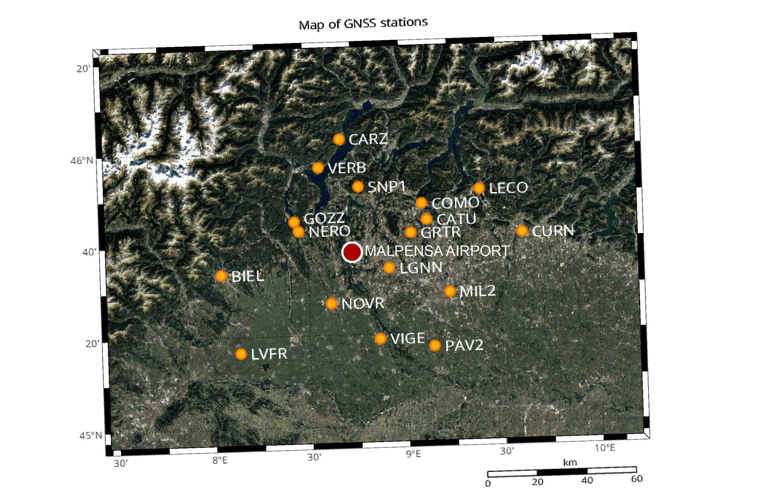
Case Study – GNSS Stations

Slide 37
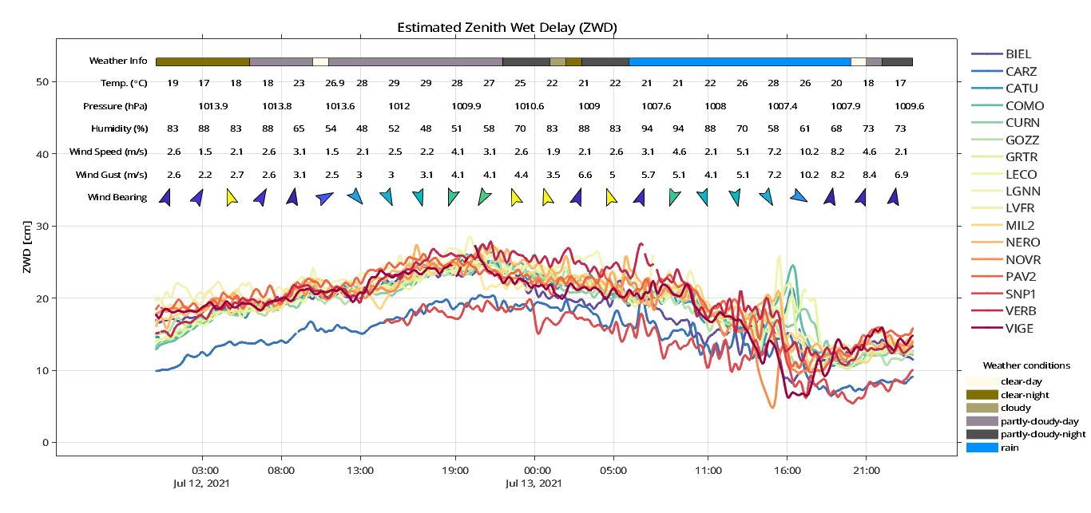
Case Study – Plot

Slide 38
Conclusion
The use of GNSS for the remote sensing of atmospheric water vapour has found applications in the field of meteorology.
goGPS software can process GNSS observation data and produce time series plots of station coordinates, ZWD, ZHD, ZTD.
While analysing the plots, it will be very useful to have an additional information of meteorological conditions of the atmosphere or events at the observation station
Matlab offers the capacity to use graphical objects to add extra information to a plot
The information can be displayed for a day or multiple-days observation dataset
The only limitation is that attempting to display weather information for more than 3 days makes the appearance clumsy

Slide 39


